Slide 1
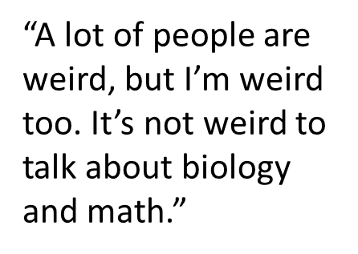
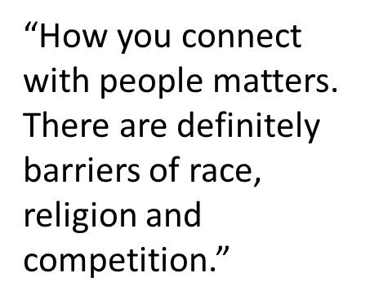
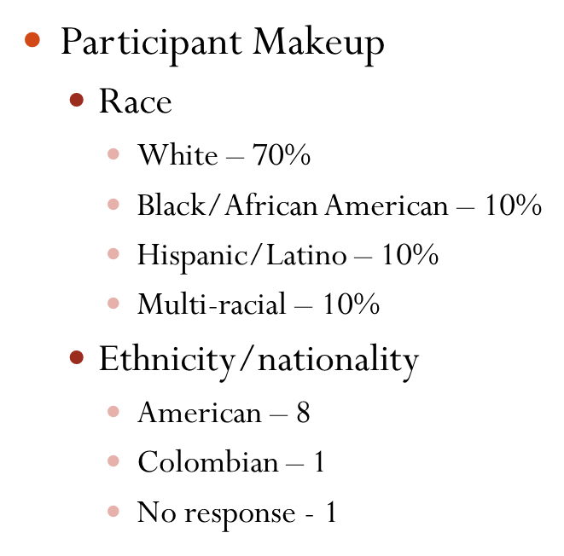
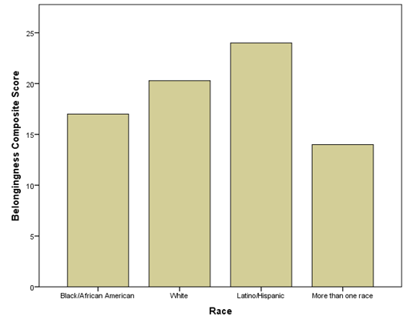
Gatton Academy and Student Sense of Belonging:
An Assessment
Danetra Hodge, Anna Williams
Gatton Academy, Western Kentucky University
ABSTRACT
FOCUS GROUP FINDINGS
METHODS & MATERIALS
Our purpose for this study was to ultimately gauge the culture and racial climate of the Carol Martin Gatton Academy of Mathematics and Sciences. This program has very unique circumstances in the higher education environment. These high-achieving high school students essentially live in a large living learning community on campus and they take college level courses while pursuing research opportunities in STEM related disciplines. In addition to determining the culture and racial climate, we sought to gather students' perceptions of their own level of acceptance and belonging within the Gatton Academy, students' perceptions of their peers level of acceptance and belonging, and also gauge how students perceive the level of support that staff provide to encourage belonging at this residential high school
The participants generally agreed that there is a sense of belonging within small groups, but not a sense of belonging as a whole community.
There are many barriers to belonging, which include: socioeconomic statuses, diverse backgrounds, and other social cliques.
The participants expressed much of their sense of belongingness is based on having similar academic interests.
The participants stated that it was difficult to get to know each other because there was not a common space for everyone to socialize.
The participants stated that everyone at Gatton embraces what little diversity they have and there are students who come from all ranges of socioeconomic statuses and usually everyone is accepting. However, there is some idea that there are heavy diversity issues die to the lack of diversity within the academy population.
The participants mentioned that staff needed more counseling training so as to better assist the students with real life problems and not just academic issues.
Data were collected using a mixed method approach which included a survey and focus group with 10 current seniors at Gatton Academy of Mathematics and Science. The 10 students were split into two focus groups of five. During the focus group, students were first given a five-item survey to complete before the focus group began.
Students were asked the following questions during the focus group:
What does having a sense of belonging look like to you?
What do you think are the effects of a student not feeling a sense of belonging?
What do you think are the effects of a student not feeling accepted by their peers?
What are some reasons you feel like you do belong in the Gatton Academy?
List 3-5 reasons why you feel or do not feel a sense of belonging here at Gatton Academy.
What are some ways, if any, you feel separated from your peers in the Gatton Academy?
How does your nationality or ethnic background factor in to how comfortable you are with peers and staff at the Gatton Academy?
What changes should Gatton Academy make to aid in a student’s sense of belonging?
What changes should the staff at the Gatton Academy make to help students feel like they belong in the Gatton Community?
The participants were given five-item survey that asked the participants to indicate the level to which they agreed or disagreed with several statements regarding belongingness, with 1 representing “Strongly Disagree” and 5 representing “Strongly Agree”. The responses to the five items were added to create a composite belongingness score. With 25 as the maximum possible score, the participants’’ maximum score was 24 and the minimum score was 14 and the average score was 19.7 .
INTRODUCTION
The Carol Martin Gatton Academy of Mathematics and Science, located on the campus of Western Kentucky University, is a highly competitive residential program for Kentucky junior and senior high school students who are interested in the STEM fields. The students take college-level courses, work with faculty on research, and have opportunities to go abroad. Students are selected based on their standardized test scores, grade point average, essay questions, personal interviews, extracurricular activities, and recommendations.
In many ways the Gatton Academy is a very large living and learning community. The students take many of the same courses together, they live in the same building, and are supported by a dedicated staff. Over the years, several researchers and practitioners have found that students who live on campus their first couple years have a tendency to feel more connected to the university campus and community (Johnson, 2007; Johnson et al., 2007). Living-learning communities have been found to be supportive in both social and networking aspects along with multicultural experiences in addition to academic advice throughout a student’s first years of college (Johnson, 2007; Hurtado et al., 2007). A student’s sense of belonging and community have been linked to improved academic success, self‑worth, and academic engagement (Wilson, Spring & Hansen, 2008). With the impact that living‑learning communities have on a student’s sense of belonging and community, we wanted to assess the experiences high school students, in particular STEM students, have while living and learning on a college campus.
I think it’s crazy how I can count on my hand, at least the number of Black people. And then if we include the people who aren’t mixed, there’s only two of us. If I include the only African American, there’s just me. I was like, wow, I’ve never been the only African American in an institution before.
PARTICIPANT DEMOGRAPHIC
I think what they do offer is very helpful if you're willing to reach out for it, but some people have complained about it in the past. I know there are differing opinions on specifically mental health care...it's not adequate enough.
Everybody's position here is kind of unstable, like someone could leave at any moment. And so I had a friend...one of the people I got closest to my first semester here, she left after the first semester. And that was kind of hard for me because everybody else had their cliques already formed and I had to find new friend groups because the person I spent all my time with wasn't there anymore.
A crosstab analysis of belongingness scores with race revealed that the participant with the highest composite score identified as Hispanic/Latino, while the participant with the lowest composite score identified as more than one race. The White participants’ scores were distributed across the sample, and the Black/African-American participant had the second-lowest score. However, when composite belongingness scores are separated by white and non-white and graphed, this slight trend becomes more evident. Nevertheless, a larger sample size would be needed to confirm a correlation between race and belongingness.
Two major themes were that the institutional structure and the social culture formed make it difficult for students to maintain a sense of belonging, which makes students feel isolated, anxious, and potentially leave the Academy.
Participants reported a feeling of belonging in Gatton based on the other students having similar interests and that they are also freer to be themselves. They touched on the idea that at their home high schools, they were isolated because of their academic achievement.
Participants also mentioned that it was difficult to really get to know all of their peers because they only have the short time frame of one year to spend with half of them.
It was noted that the living arrangements negatively impacted their sense of belonging as there was not a common area on their living floor to interact.
The participants believed there was more of a divide of what students consider to be ethical or moral. Some of this was centered on how students spend their time, studying versus other activities, and how loud students play their music or how late they stay awake.
Ethnic background does play a role in their sense of belonging because there is so little diversity at Gatton.
CONCLUSIONS
These focus groups provided the research team with many valuable perspectives of the sense of belonging at Gatton Academy. The data gathered shows that the Gatton students have various opinions about why they do or do not belong in their living learning community. However, major themes such as academic competition, lack of diversity, the formation of small social cliques, the physical set-up of living accommodations, and the need for an increase in helping skills became evident when looking at why students do not feel that they belong. Based on the discussions that arose out of the focus group assessment, recommendations can be made to increase the sense of belonging at the Gatton Academy of Mathematics and Science.
RECOMMENDATIONS
LIMITATIONS
REFERENCES
Further investigate sense of belonging and its ties to race and ethnicity and assess on a yearly basis the state of belonging of Gatton students in the WKU community.
Offer professional development with a focus on helping skills, multicultural understanding, and professional standards, especially confidentially, to all faculty and staff of the Gatton Academy, including Residential Counselors.
Encourage more interaction between upper administration and students through programming initiatives outside of regular office hours.
Increase class‑specific activities for relationship building within classes.
Increase in residential programming for all students, not just floor specific. Programming should include multicultural workshops.
Establish a mentor program between seniors and juniors.
Small focus group size
Participants all from Senior Class
Inconsistency across both groups as the groups met separately and different moderators and notetakers were used.
Parent approval was needed prior to participation.
Participants in focus group two knew one of the note takers.
Hurtado, S., Han, J. C., Sáenz, V. B., Espinosa, L. L., Cabrera, N. L., & Cerna, O. S. (2007). Predicting transition and adjustment to college: Biomedical and behavioral science aspirants’ and minority students’ first year of college. Research in Higher Education, 48(7), 841–887.
Johnson, D. (2007). Sense of belonging among Women of Color in science, technology, engineering and math majors: Investing the contributions of campus racial climate perceptions and other college environments (Doctoral dissertation, University of Maryland, College Park). Available from ProQuest Dissertations and Theses database. (UMI No. AAT 3297338).
Johnson, D. R., Soldner, M., Leonard, J. B., Alvarez, P., Inkelas, K. K., Rowan-Kenyon, H., & Longerbeam, S. (2007). Examining sense of belonging among first-year undergraduates from different racial/ethnic groups. Journal of College Student Development, 48(5), 525–542.
Spanierman, L., Soble, J., Mayfield, J., Neville, H., Aber, M., Khuri, L., & De La Rosa, B. (2013). Living learning communities and students’ sense of community and belonging. Journal of Student Affairs Research and Practice, 50(3)

